Slide 1
Twilio Product Study
Link: www.twilio.com

Slide 2
Introduction
Considering twilio.com web traffic data this report is a built to analyze approaches to measure metrics and build predictions & recommendation.
Some of the key features are highlighted and a detailed approach can be followed once there is a access of complete data.

Slide 3
Problems
Customers facing issues with the interface
Customer support issues
High Bounce rate from website visitors
A more customer friendly application
High response time
Tracking unnecessary contact to customers
Few of the commonly identified problems as per the research

Slide 4
Solutions
Predicting the business behaviour utilizing the historical trends.
Predicting usage analytics as per the user personas
Forecasting the trend in traffic & conversion rate.
Customizable solutions to users.
Possible solutions to approach the issue.

Slide 5
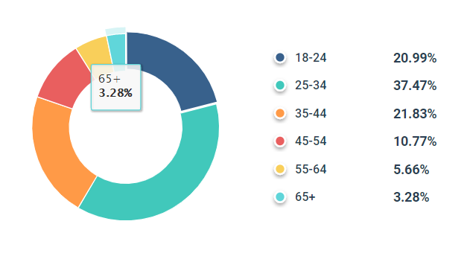
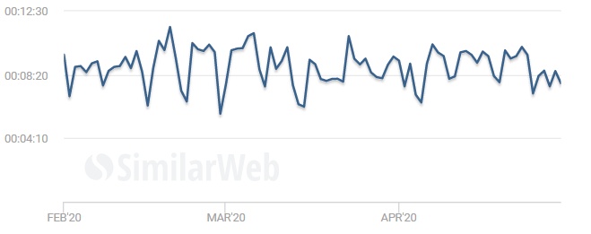
Last 3 months Metrcis-1
Age distribution
Average Visit Time

Slide 6
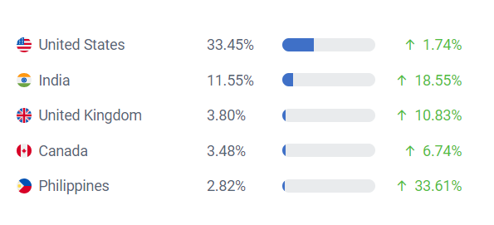
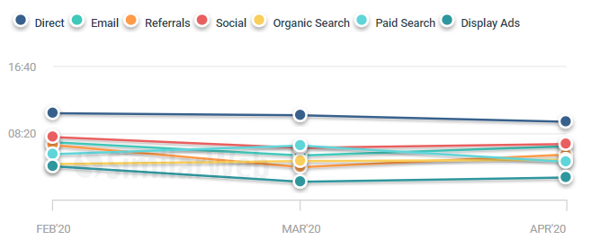
Last 3 months Metrcis-2
Geographical Distribution
Avg. Visit Duration By Channel

Slide 7
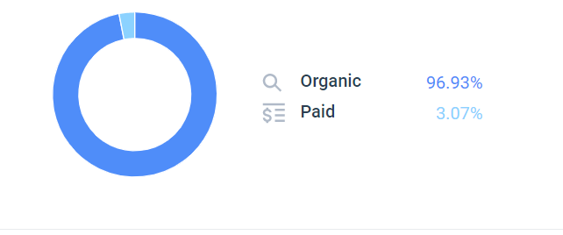
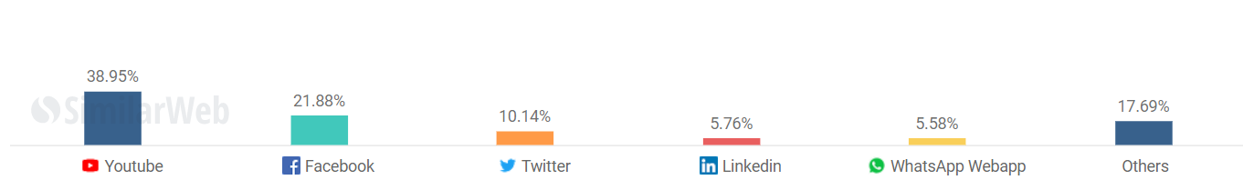
Last 3 months Metrcis-3
Medium of search Traffic
Social Network Traffic

Slide 8
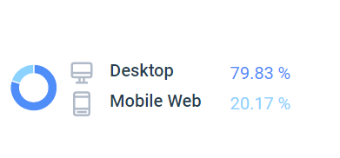
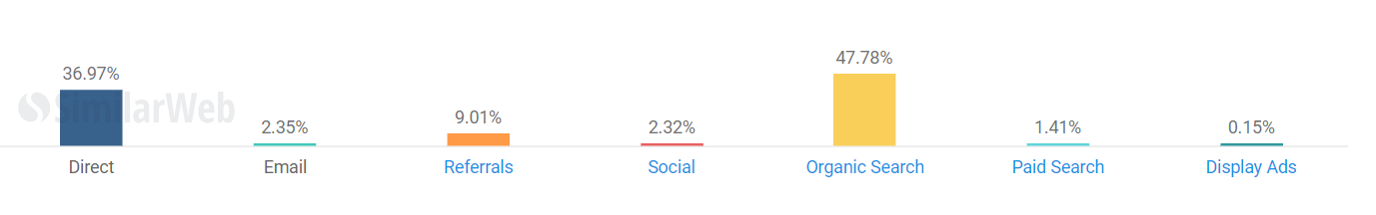
Last 3 months Metrcis-4
Device search Traffic
Referral Traffic

Slide 9
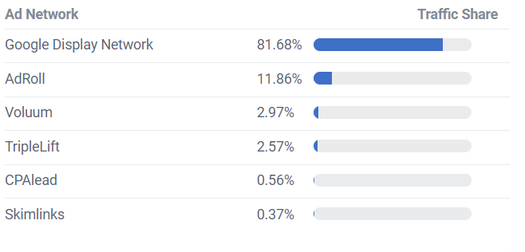
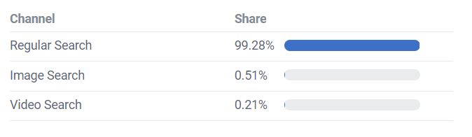
Last 3 months Metrcis-5
Ad Network traffic share
Search by Search Type

Slide 10
Session Duration - 05:53 minutes; 7.08 pageviews per Session, and Bounce Rate - 46.7%.
38.3 percent of visits to this site come from a search engine, while 52.6% come directly and 9.1% via a hyperlink somewhere on the internet
Most sessions are initiated from United States of America - 36.8%, India - 12.8%, United Kingdom (UK) - 3.9%, Canada - 2.8%, Philippines - 2.1%
Stats
Approach/Road Map
Customers between age group between 25 – 34 share the highest visiting.
Majority of the traffic is generated from website compared to mobile app.
Google ads drive the major traffic to the site.
Few significant observations from the previous metrics

Slide 11
Approach
Based on some of the features identified customer personas can be studied.
Conversion rate can be analysed as per the different features such as demography, age, visiting duration etc.
Detailed data exploration and analysis is possible gain insights from the data.
A predictive model can be built taking the relevant features to forecast customer behaviour using AI/ML model.
As per the analysis a recommendation system can be built to customize solutions and reduce response time.
Target audience can be identified based on existing customers, exited customers and reduce future attrition rate.

Slide 12
Possible Hypothesis
Visitors spending average of 6 mins or more on the website from US and aged between 25-34 are more likely to become future customers.
Identifying the behavior of unique visitors might lead to more traffic
Displaying ads in the other user interest sites might lead to more traffic.
Information about bounce rate can used to increased customer understanding.

Slide 13
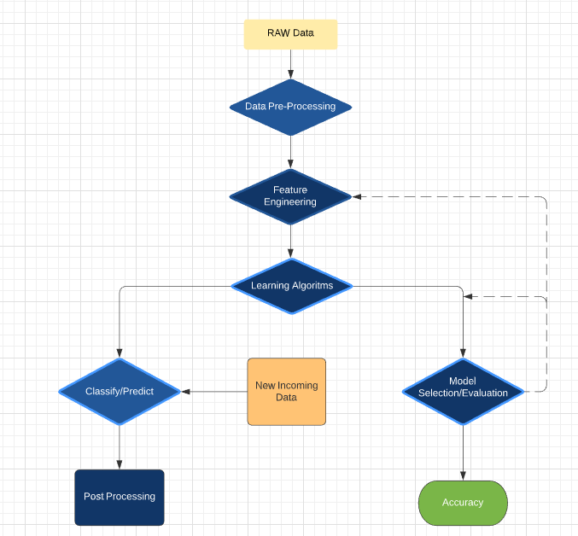
Data Analysis & Modeling roadmap

Slide 14
Sources of data
Web and Browsing data
• GPS / Location data
• Images and Videos
• User Generated Content (UGC)
• Devices with sensors
Emails
Financial transactions
In addition to previously mentioned sources, few other data sources are listed which might help in better insight generation

Slide 15
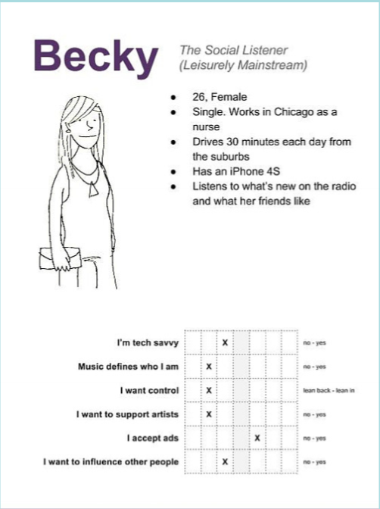
User Persona example

Slide 16
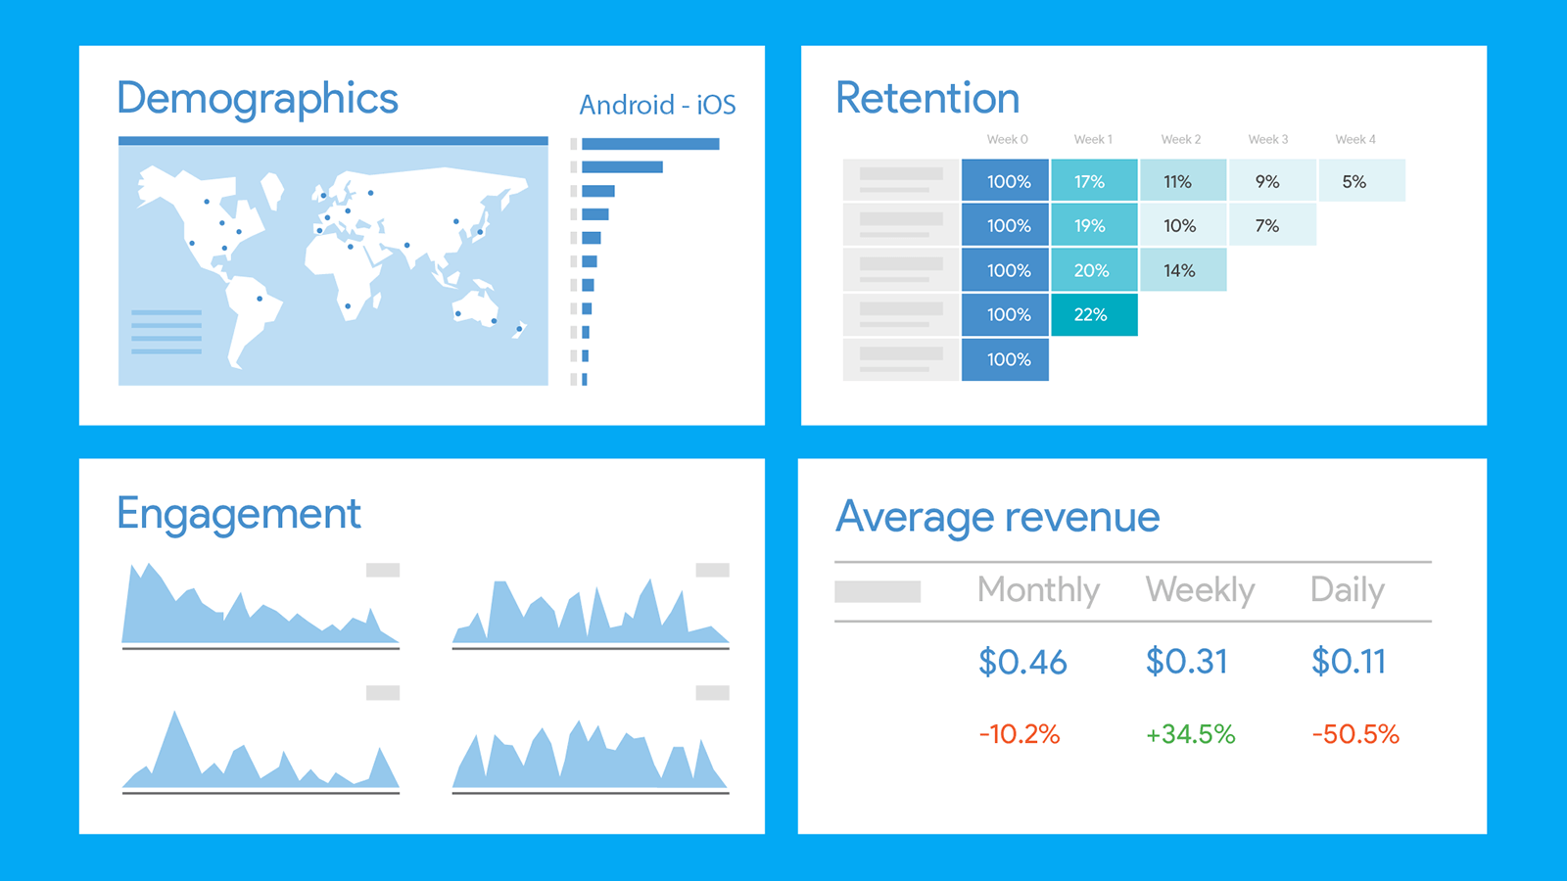
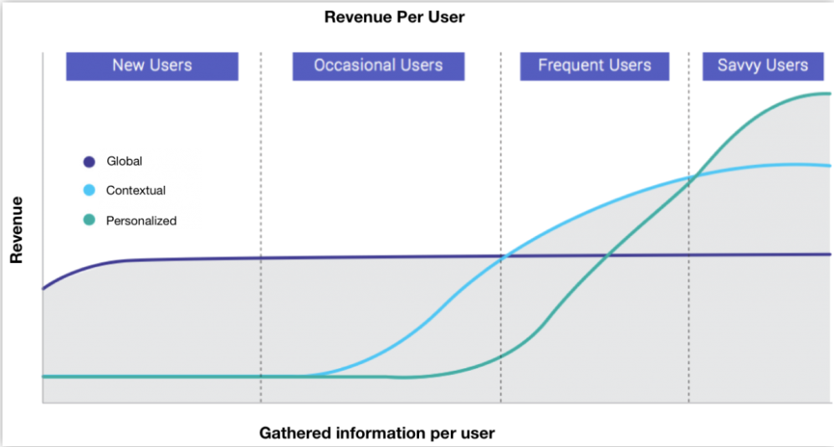
Usage analytics example
Optimizing the Customer Journey and get users to take the intended actions
Optimizing User Journey to get users to complete their tasks efficiently
Understanding bottlenecks in tasks that Users perform thereby reducing friction in User Experience.

Slide 17
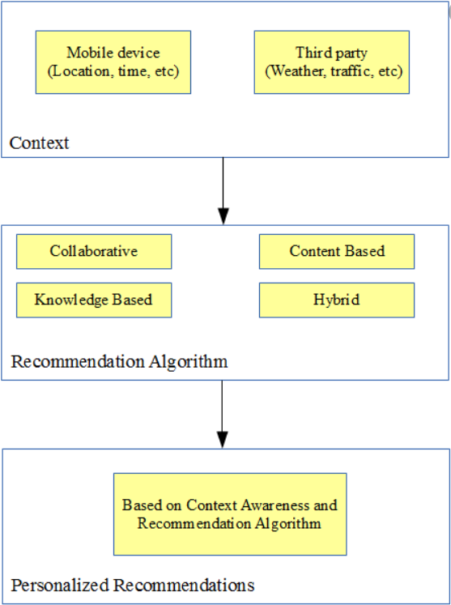
Recommendation system prototype

Slide 18
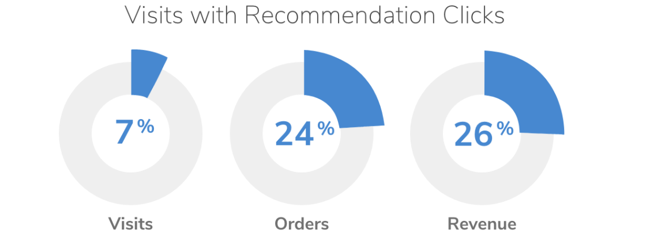
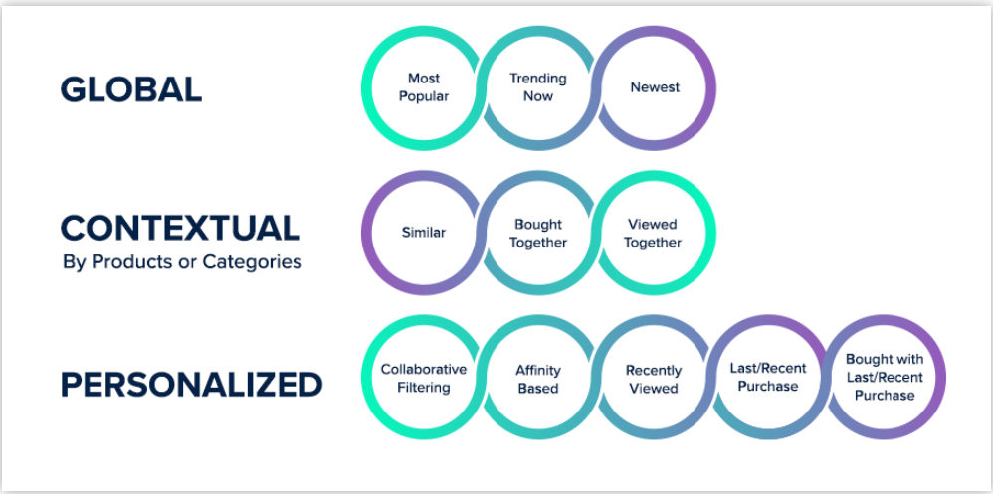
Recommendation system example

Slide 19
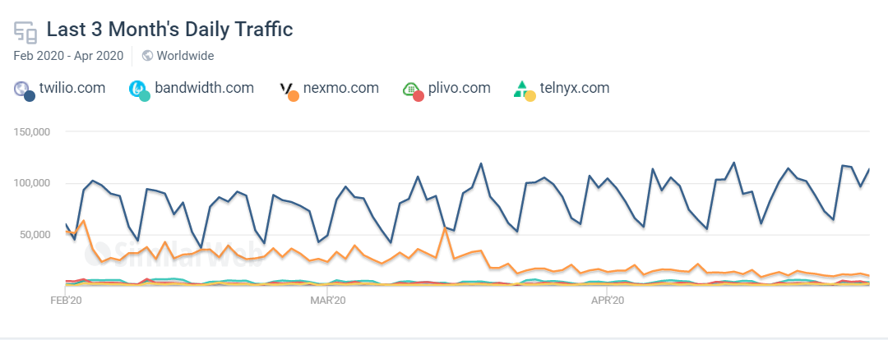
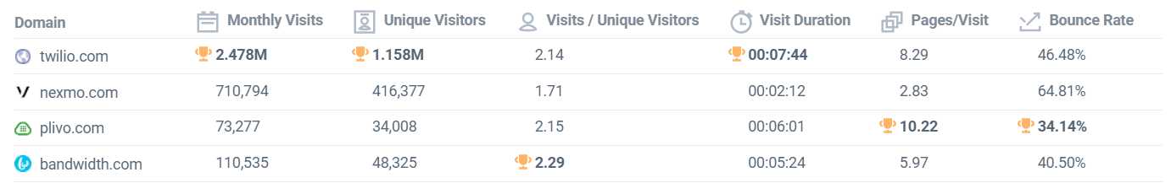
Competitor Analysis
Daily Traffic
Traffic share with competitors

Slide 20
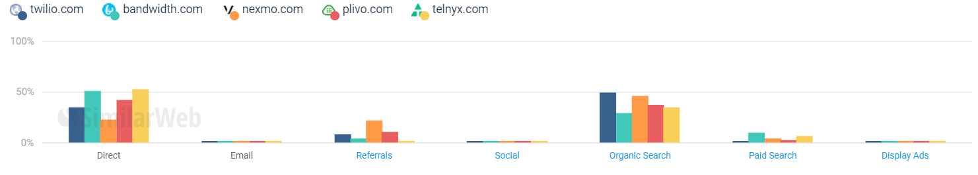
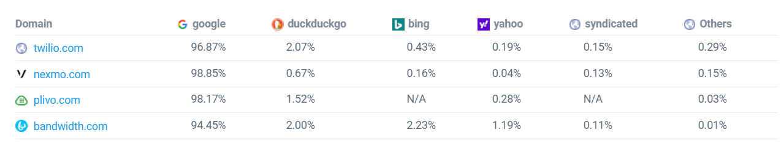
Competitor Analysis
Mode of search
Search engine share

Slide 21
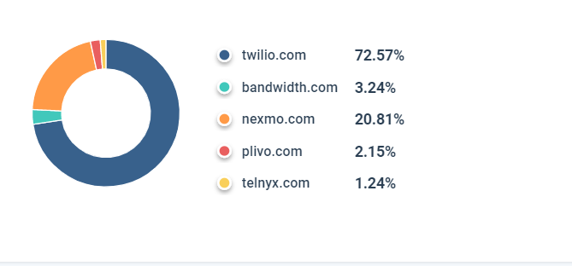
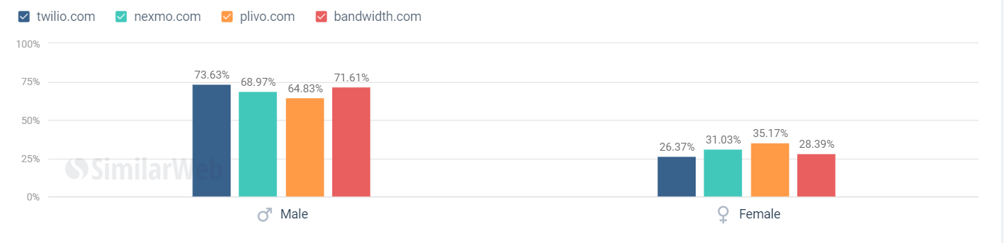
Competitor Analysis
Total Market share
Gender Ratio

Slide 22
Competitor Analysis Observations
A clear seasonality is observed during weekends compared to competitors, which can be analysed using business behaviour and user analysis from the data.
Unique visitor ratio to be focused and improved in combination with usage analytics and recommendation
Customer personas for high bounce rates could be analysed with detailed approach.

Slide 23
Conclusion
A good data analysis will help to understand the customer behaviour accurately.
With a good recommendation system and customizable solutions attrition rate can be minimized
Usage analytics leads to gaining upper hand against competitors
It helps in generating more quality data and reduced response time to customers

